Slide 1
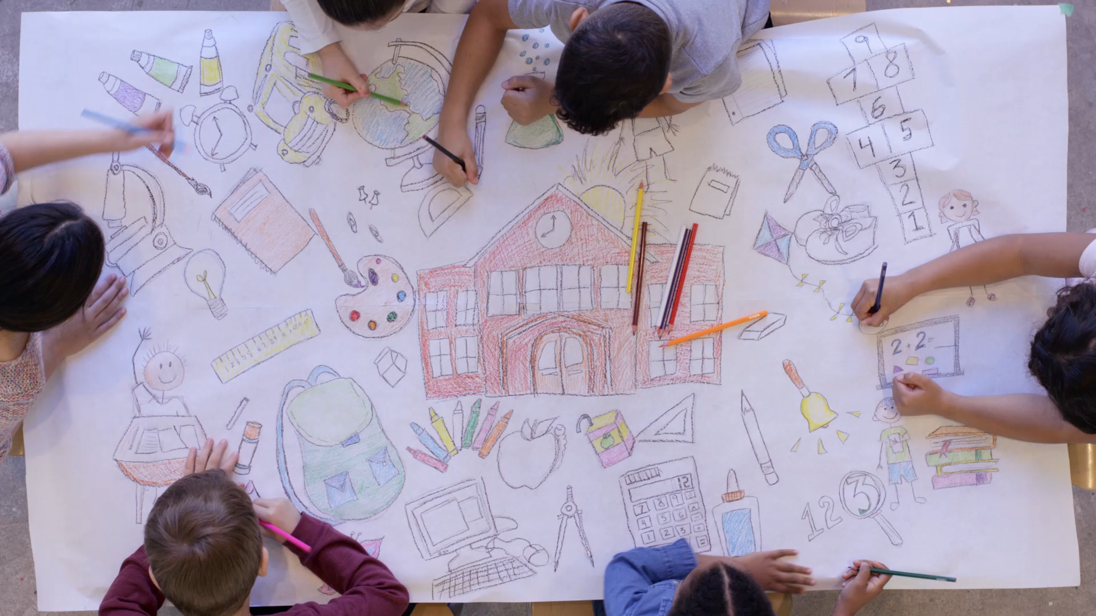
Writing BASE

Slide 2
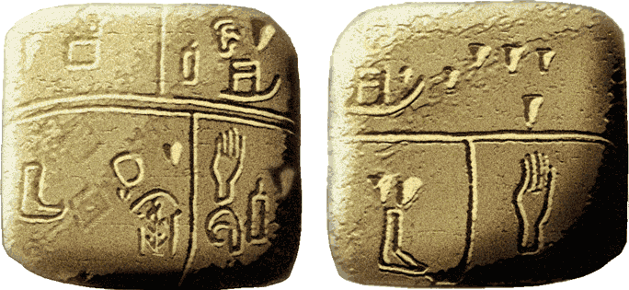
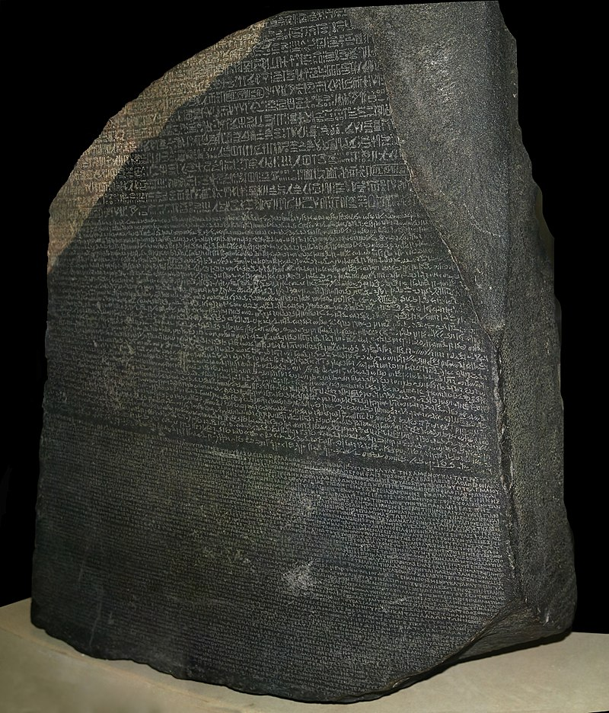
Why Write?
The Kish tablet from Sumer, with pictographic writing. This may be the earliest known writing, 3500 BCE. Ashmolean Museum
The Rosetta Stone, with writing in three different scripts, was instrumental in deciphering Ancient Egyptian.

Slide 3
Why Write?
A means of rendering language into a form that can be reconstructed by other humans separated by time and/or space.
Wikipedia
“The rule is simple: if you don’t write it down, it never happened.”
Michael Lopp

Slide 4
What is Writer’s Base?

Slide 5
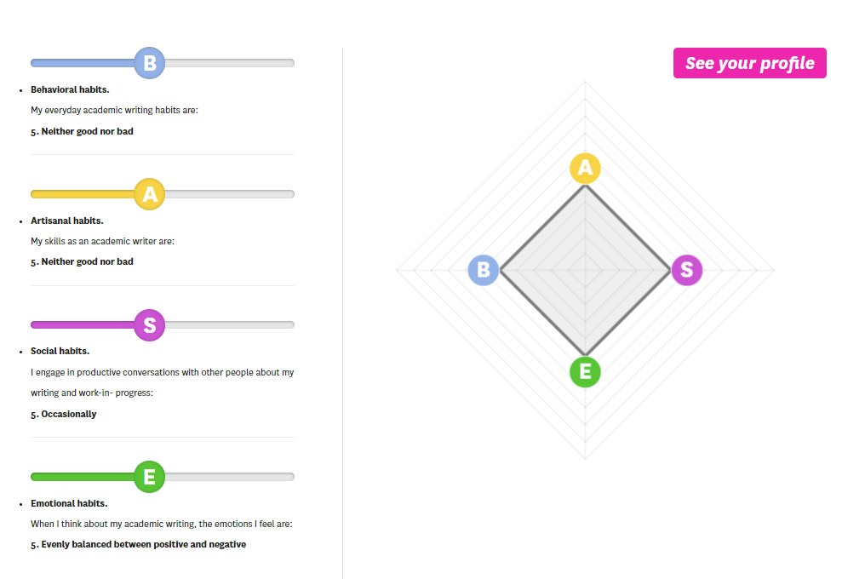
https://writersdiet.com/base/base/

